Slide 1
Bank Marketing: To Predict if the client will Subscribe for Term Deposit

Slide 2
Bank Marketing
In simple words, bank marketing is the design structure, layout and delivery of customer-needed services worked out by checking out the corporate objectives of the bank and environmental constraints.
Why is marketing important for banks?
The banking sector plays a key role in the development of the economy. Banks are now giving importance to the marketing activities to create awareness regarding their services to the public. Customer satisfaction is important so that banks are introducing new instruments and ways to attract the customers.

Slide 3
Problem Statement:
Based on the census, personal details, financial details and other marketing campaign, predict if the customer will Subscribe for Term Deposit.

Slide 4
Overview
This is the classic marketing bank dataset uploaded originally in the UCI Machine Learning Repository. The dataset gives information about a marketing campaign of a financial institution in which we will analyze in order to find ways to look for future strategies in order to improve future marketing campaigns for the bank.
Gaining the maximum value from a particular data collection is a challenging endeavor since it necessitates a thorough analysis of its many properties and accompanying values. In order to uncover hidden patterns, this process is typically accomplished by presenting data in a visual way.
In this study, a bank's direct marketing data collection is subjected to several visualization approaches.
The data set that was downloaded from the website of the UCI machine learning repository is unbalanced. As a result, several oversampling techniques are employed to improve the predictability of a client's subscription to a term deposit. The effectiveness of the visualization is evaluated by examining the impact of various classifier performance on oversampling strategies.
With various feature engineering Technique, we be using different Ensemble Models to Predict the outcome.

Slide 5
Literature Review
Deal Banking Marketing Campaign Dataset with Machine Learning: They used data related to marketing campaigns (phone calls) of a Portuguese banking institution. The classification goal is to predict if the client will subscribe a term deposit.
“Marketing analytics: Methods, practice, implementation, and links to other fields,” Expert Systems with Applications: The research in this paper examined the theoretical underpinnings of marketing analytics, a vast discipline that emerged from operations research, marketing, statistics, and computer science. One of the difficulties in doing a direct marketing analysis, they claimed, is forecasting consumer behavior. They also covered customer relationship management, multidimensional scaling, correspondence analysis, and latent Dirichlet allocation as big data visualization techniques for the marketing sector.
“Customer profiling using classification approach for bank telemarketing,” JOIV: International Journal on Informatics Visualization: This article used the same data set for additional consumer profiling objectives. On the expanded version of the data set analyzed in the current work, naive Bayes, random forests, and decision trees were employed. Prior to assessing the classifiers, preprocessing and normalization were carried out. To carry out the trials and assessment procedures, RapidMiner was employed.

Slide 6
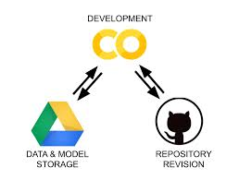
Architecture and Technology
We use Python for Data Processing and Modelling and
The system OS we have used is Linux.
Environment on Colab Notebook.
User → Google Linux Server → Google Storage Bucket → Processing on Google Server.

Slide 7
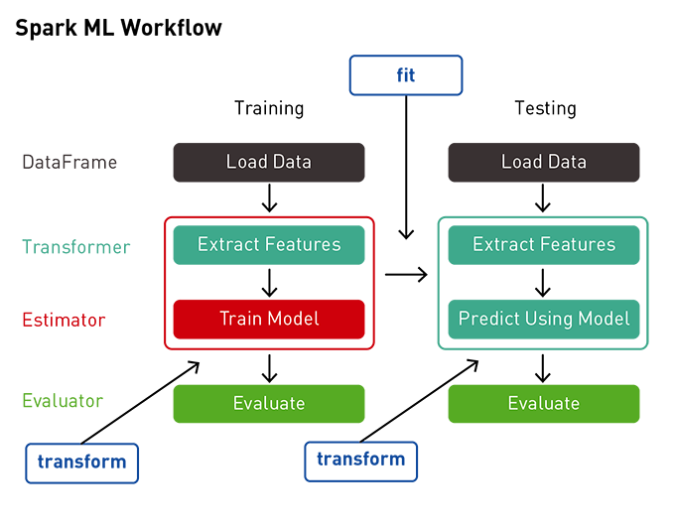

Slide 8
About Dataset
The data is related with direct marketing campaigns (phone calls) of a Portuguese banking institution. The classification goal is to predict if the client will subscribe a term deposit (variable y).
The data is related with direct marketing campaigns of a Portuguese banking institution. The marketing campaigns were based on phone calls. Often, more than one contact to the same client was required, in order to access if the product (bank term deposit) would be ('yes') or not ('no') subscribed.
Data consists of 21 features and 41189 entries including personal and professional information of the Client
Dataset Link: http://archive.ics.uci.edu/ml/datasets/Bank+Marketing#

Slide 9
Steps Performed:
Downloading and Setting up PySpark in COLAB
Loading Data
Short visualization on data
Preparing dataset for training
Building Machine Learning Models
Validation for comparison of different models using AUC

Slide 10
Visualization

Slide 11
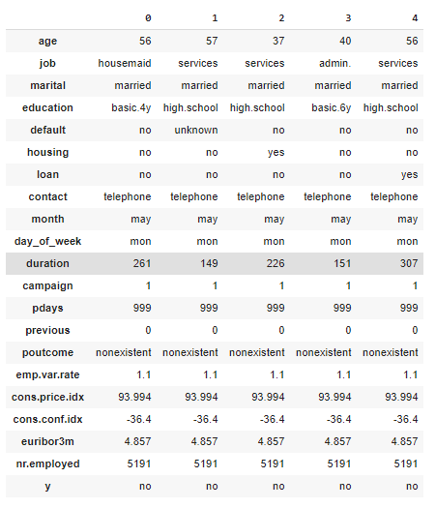
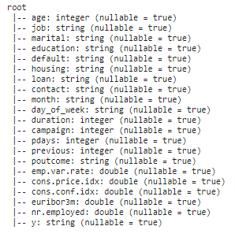
Glimpse of the Dataset
Data Type of each column: We can see that data is mix of integers and string

Slide 12
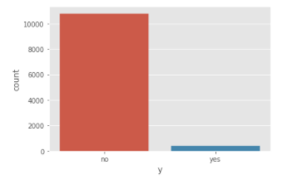

Here we can see Data set is imbalanced
Therefore, there is a need to use Perform up sampling techniques.

Slide 13
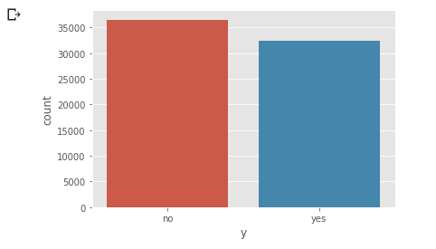

After Up Sampling the data

Slide 14
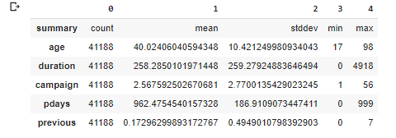
Here we can see some basic statistical aggregations of the numerical columns. Like Age of the customers are between 18-95,etc

Slide 15
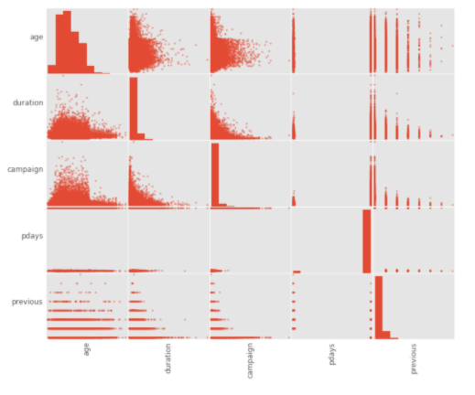
Pair Plot
- There are no obvious highly correlated variable pairs - Let's remove day and month, but keep the rest of the variables - 14 input/predictor variables, 1 response/target variable

Slide 16
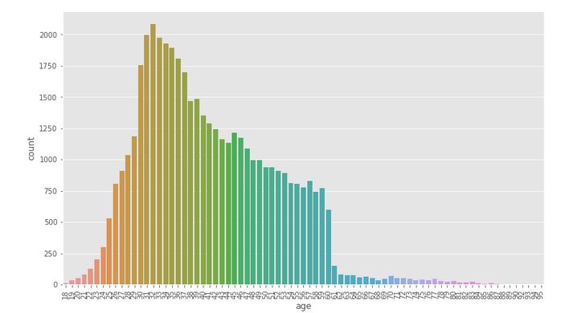
By looking at the distribution :
We can see that distribution is rightly skewed and most of the customers are between the age of 25-60

Slide 17
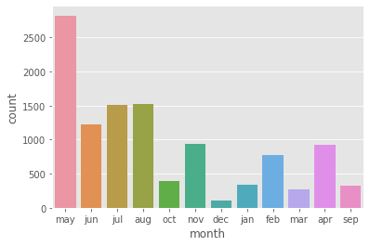
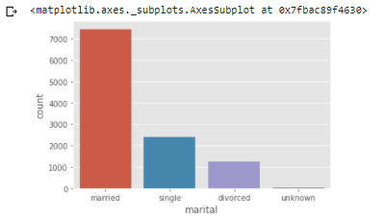
We can see that Most of the customers are Married
Marketing we Hight active between May- Aug
In May the campaign might be in pace

Slide 18
Pre-processing Before Modelling
Looking for NA values
Train Test Split
Label encoding
Choosing relevant variables
Up sampling Data
Vectorizing the data

Slide 19
Basic Models used:
Logistic Regression: Logistic regression is a statistical model that in its basic form uses a logistic function to model a binary dependent variable, although many more complex extensions exist. In regression analysis, logistic regression (or logit regression) is estimating the parameters of a logistic model (a form of binary regression).
Decision Tree:A decision tree is a flowchart-like structure in which each internal node represents a "test" on an attribute (e.g. whether a coin flip comes up heads or tails), each branch represents the outcome of the test, and each leaf node represents a class label (decision taken after computing all attributes).

Slide 20
Ensemble models used:
Random Forest:Random forests or random decision forests are an ensemble learning method for classification, regression and other tasks that operate by constructing a multitude of decision trees at training time and outputting the class that is the mode of the classes (classification) or mean/average prediction (regression)
Gradient Boosting: Gradient boosting is a machine learning technique for regression and classification problems, which produces a prediction model in the form of an ensemble of weak prediction models, typically decision trees.

Slide 21
Results: After ParamGrid and Crossvalidation
Logistic Regression | Decision Tree | Random Forest | Gradient Boosting
0.8960 | 0.6680 | 0.8855 | 0.9032
Conclusion:
As we can see that ROC Score for Boosting Algorithm is slight higher than the other As it converts weak learner to strong learners.
Therefore we can Move ahead with the Gradient Boosting with the Best Params which we have found using Grid Search and validated using Cross Validation.

Slide 22


Slide 23


